Slide 1
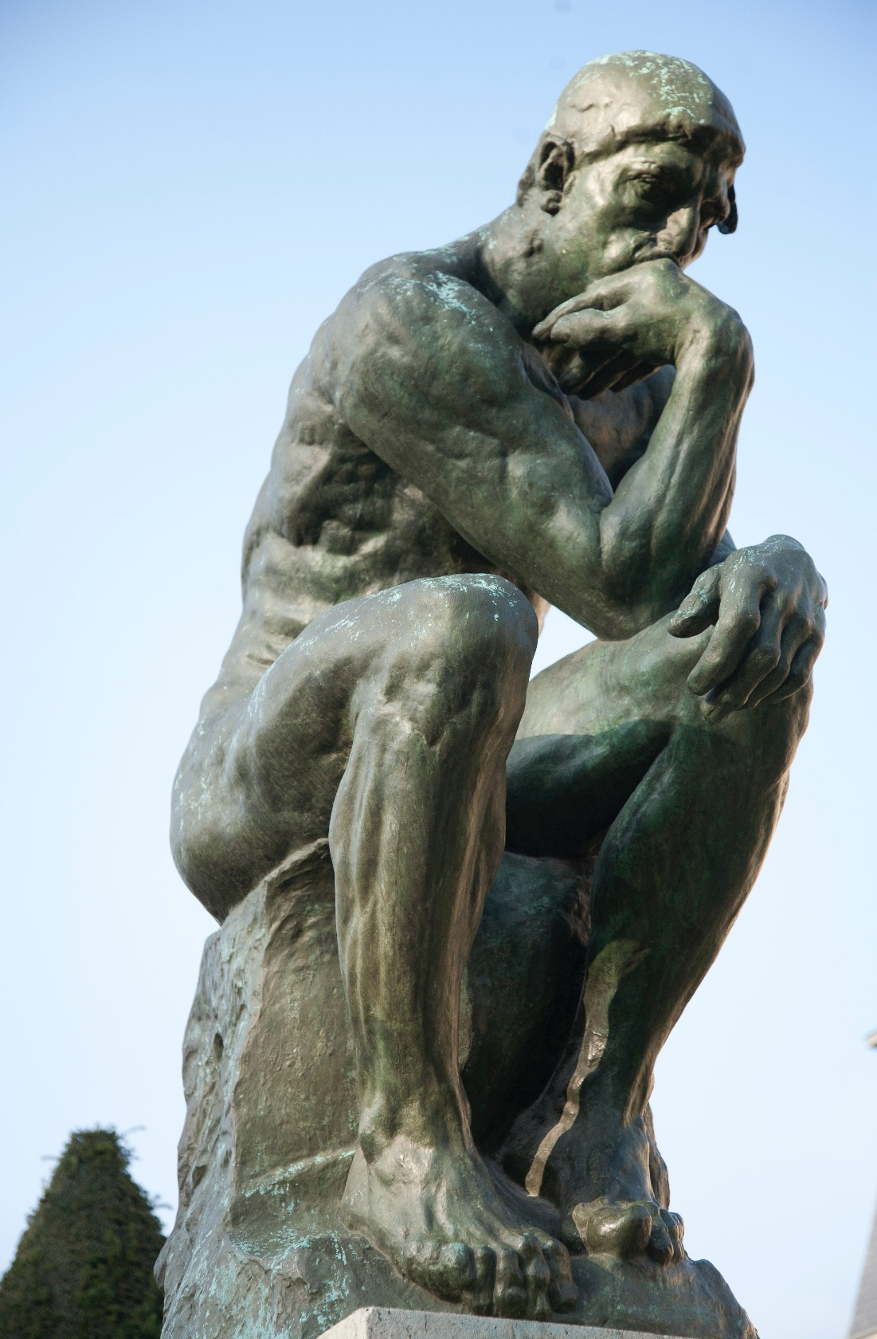
Embedded Ethics Module Recommender System Objectives
Notes:
Licensed by the University of Toronto Embedded Ethics Education Initiative and Roger Grosse under the Attribution-NonCommercial-ShareAlike 4.0 International license.
To view a copy of this license, visit https://creativecommons.org/licenses/by-nc-sa/4.0/.
Photo by Vitaly Vlasov from Pexels (https://www.pexels.com/photo/person-pointing-numeric-print-1342460/)
Photo by Charl Durand from Pexels (https://www.pexels.com/photo/the-thinker-statue-in-rodin-museum-france-6486112/)

Slide 2
The Facebook Papers
In October 2021, a number of internal Facebook documents were made public by a whistleblower named Frances Haugen.
Many thought that these documents showed that Facebook was aware of many of the ethically dubious consequences of their social media platforms.
Notes:
Image Source: Simon from Pixabay (https://pixabay.com/illustrations/facebook-social-network-network-76532/)

Slide 3
The Ethics of Recommender Systems
Our goal will be to introduce you to some ethical concepts that might be relevant to thinking about what lessons can be drawn from the Facebook Papers – and about the ethics of recommender systems in general.
Note that this is different from the legality of these issues!

Slide 4
Issue 1: Content Moderation
“Facebook researchers documented how its platform has contributed to divisive, inter-religious conflict in India, according to internal records.
Employees flagged that human traffickers in the Middle East used the site to lure women into abusive employment situations. They warned that armed groups in Ethiopia used the site to incite violence against ethnic minorities. They sent alerts to their bosses about organ selling, pornography and government action against political dissent, according to the documents. They also show the company’s response, which in many instances is inadequate or nothing at all.” (Source: Wall Street Journal, https://www.wsj.com/articles/the-facebook-files-11631713039)
Notes:
Image Source: Photo by Vitalina from Pexels (https://www.pexels.com/photo/people-at-a-protest-at-night-3807381/)

Slide 5
Issue 1: Content Moderation
{ }
Clicks
Viewing time
Engagement
Logins
Etc.
To maximize
Choose which of these to present to the user
Notes:
The objective function is what is trying to be maximized through choices of what to present.
Images (from upper left, clockwise):
Image 1 Source: Photo by Eternal Happiness from Pexels (https://www.pexels.com/photo/photo-of-woman-posing-during-golden-hour-3326362/)
Image 2 Source: Photo by Artem Beliaikin from Pexels (https://www.pexels.com/photo/woman-riding-big-swing-in-front-of-waterfalls-1319795/)
Image 3 Source: Photo by Gratisography from Pexels (https://www.pexels.com/photo/man-person-red-white-476/)
Image 4 Source: Photo by moein moradi from Pexels (https://www.pexels.com/photo/photograph-of-a-burning-fire-672636/)
Image 5 Source: Photo by Skitter Photo from Pexels (https://www.pexels.com/photo/arms-blur-close-up-firing-370202/)
Image 6 Source: Photo by Burst from Pexels (https://www.pexels.com/photo/cn-tower-in-toronto-374870/)

Slide 6
Issue 1: Content Moderation
{ }
Clicks
Viewing time
Engagement
Logins
Etc.
To maximize
Choose which of these to present to the user, when to present them, in what order….
The problem of content moderation: are there any posts that should not be presented under any circumstances?
Notes:
Images (from upper left, clockwise):
Image 1 Source: Photo by Eternal Happiness from Pexels (https://www.pexels.com/photo/photo-of-woman-posing-during-golden-hour-3326362/)
Image 2 Source: Photo by Artem Beliaikin from Pexels (https://www.pexels.com/photo/woman-riding-big-swing-in-front-of-waterfalls-1319795/)
Image 3 Source: Photo by Gratisography from Pexels (https://www.pexels.com/photo/man-person-red-white-476/)
Image 4 Source: Photo by moein moradi from Pexels (https://www.pexels.com/photo/photograph-of-a-burning-fire-672636/)
Image 5 Source: Photo by Skitter Photo from Pexels (https://www.pexels.com/photo/arms-blur-close-up-firing-370202/)
Image 6 Source: Photo by Burst from Pexels (https://www.pexels.com/photo/cn-tower-in-toronto-374870/)

Slide 7
Discussion Question
Instructions for building an untraceable assault rifle
False information claiming that COVID vaccines cause autism
A call to “take back” Parliament through force
Which of these posts, if any, should be prohibited on a social media platform?
Insert link to poll
Notes:
Image 1 Source: Photo by Specna Arms from Pexels (https://www.pexels.com/photo/black-rifle-889709/)
Image 2 Source: Photo by RF._.studio from Pexels (https://www.pexels.com/photo/person-holding-injection-3825529/)
Image 3 Source: Photo by Tetyana Kovyrina from Pexels (https://www.pexels.com/photo/photo-of-beige-and-green-castle-1045915/)
Background Image Source: Robin Higgins at pixabay (https://pixabay.com/photos/thinking-person-person-thinking-2681494/)

Slide 8
Discussion Question
In the chat (or raise your hand to speak):
What principle (if any) guided your judgments about which content to prohibit?
Notes:
Background Image Source: Robin Higgins at pixabay (https://pixabay.com/photos/thinking-person-person-thinking-2681494/)

Slide 9
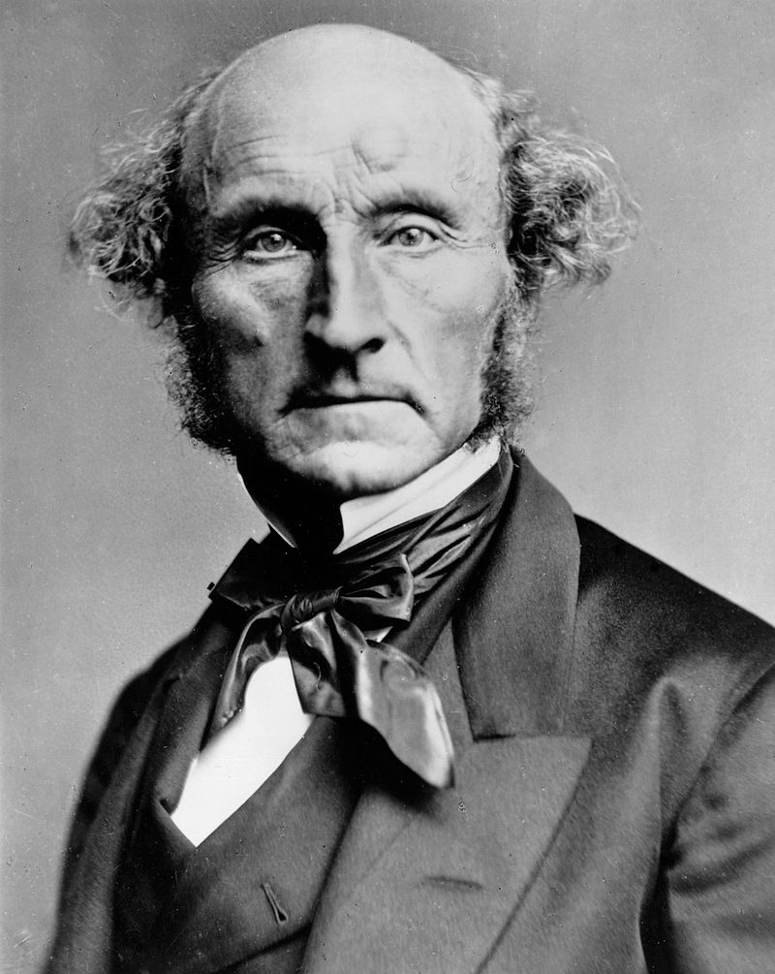
Issue 1: Content Moderation
Mill’s Harm Principle
“The object of this Essay is to assert one very simple principle, as entitled to govern absolutely the dealings of society with the individual in the way of compulsion and control, whether the means used be physical force in the form of legal penalties, or the moral coercion of public opinion. That principle is, that the sole end for which mankind are warranted, individually or collectively, in interfering with the liberty of action of any of their number, is self-protection. That the only purpose for which power can be rightfully exercised over any member of a civilised community, against his will, is to prevent harm to others.” (Mill, On Liberty)

Slide 10
Issue 1: Content Moderation
Mill thought that the Harm Principle implied very strong protections for speech:
“If all mankind minus one were of one opinion, and only one person were of the contrary opinion, mankind would be no more justified in silencing that one person, than he, if he had the power, would be justified in silencing mankind.” (Mill, 18)

Slide 11
Issue 1: Content Moderation
Mill’s argument for this conclusion rests on the importance of free speech and debate in coming to know the truth:
“If the opinion is right, they are deprived of the opportunity of exchanging error for truth: if wrong, they lose, what is almost as great a benefit, the clearer perception and livelier impression of truth, produced by its collision with error.” (Mill, 18)
As a result, he thinks that speech should only be prohibited in cases where it results in a direct harm to a specific person (e.g. inciting a crowd to harm them, or lying about them in a way that harms their reputation)

Slide 12
Discussion Question
In the chat (or raise your hand to speak):
Going back to our three examples:
Gun manufacturing instructions
False COVID information
A call to “take back” Parliament
How compelling do you find Mill’s argument for each of these three examples?
Notes:
Background Image Source: Robin Higgins at pixabay (https://pixabay.com/photos/thinking-person-person-thinking-2681494/)

Slide 13
Discussion Question
In the chat (or raise your hand to speak):
Let’s now assume that there are no failures of content moderation.
What other ethical issues might arise with recommender systems?
Notes:
Background Image Source: Robin Higgins at pixabay (https://pixabay.com/photos/thinking-person-person-thinking-2681494/)

Slide 14
Issue 2: The Feed
Recommender systems don’t just give users the opportunity to look up certain content they are interested in.
They also choose which content to amplify (by posting it more prominently or more often).

Slide 15
{ }
Clicks
Viewing time
Engagement
Logins
Etc
To maximize
…….
…….
…….
Choose between….
Notes:
Image 1 Source: Photo by Eternal Happiness from Pexels (https://www.pexels.com/photo/photo-of-woman-posing-during-golden-hour-3326362/)
Image 2 Source: Photo by Artem Beliaikin from Pexels (https://www.pexels.com/photo/woman-riding-big-swing-in-front-of-waterfalls-1319795/)
Image 3 Source: Photo by Gratisography from Pexels (https://www.pexels.com/photo/man-person-red-white-476/)
Image 4 Source: Photo by Burst from Pexels (https://www.pexels.com/photo/cn-tower-in-toronto-374870/)

Slide 16
Issue 2: The Feed
In deciding which posts to present to users, Facebook has an explicit formula describing the relative weights of certain factors.
Facebook introduced this formula in order to drive more meaningful interactions.
“The goal of the algorithm change was to reverse the decline in comments, and other forms of engagement, and to encourage more original posting. It would reward posts that garnered more comments and emotion emojis, which were viewed as more meaningful than likes, the documents show.”
Wall Street Journal, “Facebook Tried to Make Its Platform a Healthier Place. It Got Angrier Instead”

Slide 17
Issue 2: The Feed
“While the FB platform offers people the opportunity to connect, share and engage, an unfortunate side effect is that harmful and misinformative content can go viral, often before we can catch it and mitigate its effects,” he wrote. “Political operatives and publishers tell us that they rely more on negativity and sensationalism for distribution due to recent algorithmic changes that favor reshares.” (Internal Facebook Memo, quoted by the Wall Street Journal)
Notes:
Image Source: Photo by Timur Weber from Pexels (https://www.pexels.com/photo/a-couple-arguing-while-holding-each-others-arms-8560358/)

Slide 18
Group Exercise
We will look at four cases showing different ways that social media platforms might influence their users.
For each case presented:
Discuss each case as a group. Discuss whether they are ethical or unethical. Submit one answer per group via google form, attempting to capture the consensus in your group. [10 minutes]
[insert Google form link]
We will then take a vote on how unethical you individually think the influence is, on a scale from 1 (raises no ethical problems) to 5 (very unethical, to the point that it should be legally prohibited).
Notes:
Have instructions ready to go, make sure google form link gets propagated.

Slide 19
Group Exercise
Examples:
A recommender algorithm that presents users with advertisements similar to the posts they have clicked on in the past.
A recommender system that presents advertisements for expensive luxuries when it judges that a user is stressed or feels like a failure, based upon the language of their posts, messages and click history.
A recommender system that presents users with posts that many would find offensive, in order to determine whether the user would like to see that content (like a bandit algorithm), but does not show them again unless the user engages with them.
A recommender system that presents users pictures of cute animals over and over again, to the exclusion of other content, when the user has a compulsion to look at pictures of cute animals

Slide 20
The Ethics of Recommender Systems
Example | Average value on a scale of 1 (no ethical problems) to 5 (highly unethical)
A recommender algorithm that presents users with advertisements similar to the posts they have clicked on in the past.
A recommender system that chooses advertisements based on whether it judges that a user is stressed or feels like a failure.
A recommender system that presents users with offensive content in order to determine whether the user would like to see that content (like a bandit algorithm).
A recommender system that presents users pictures of cute animals over and over again, to the exclusion of other content, when the user has a compulsion to look at pictures of cute animals.

Slide 21
Issue 2: The Feed
One concept that might help make sense of your intuitions on the previous questions is manipulation.
Notes:
Background Image: kaboompics at pixabay (https://pixabay.com/photos/wooden-mannequin-wooden-mannequin-791720/)

Slide 22
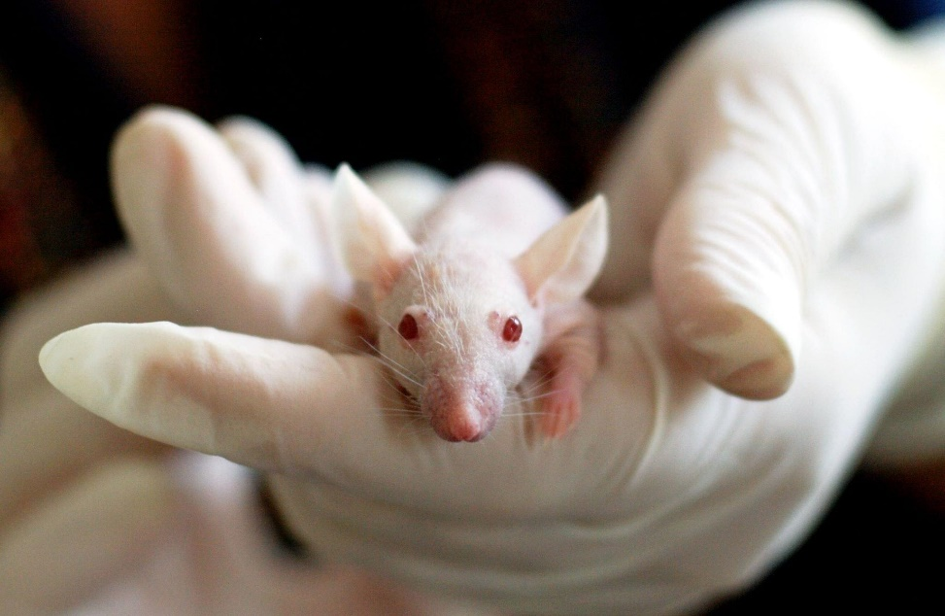
Example 1: Conditioning
Conditioning is an attempt to get someone to adopt a pattern of behaviour by rewarding or punishing their actions.
Notes:
Background Image: kaboompics at pixabay (https://pixabay.com/photos/wooden-mannequin-wooden-mannequin-791720/)
Image Source: https://www.pexels.com/photo/white-baby-mouse-159483/

Slide 23
Example 2: The Guilt Trip
A guilt trip is using an inappropriate amount of guilt to influence someone to do something.
Notes:
Background Image: kaboompics at pixabay (https://pixabay.com/photos/wooden-mannequin-wooden-mannequin-791720/)
Image by Pexels from Pixabay (https://pixabay.com/photos/dog-pet-puppy-lying-down-sad-1846066/)

Slide 24
Example 3: Gaslighting
Gaslighting is an attempt to get someone to do something by (falsely) persuading them that their judgment is generally flawed or even delusional.
Notes:
Gaslight: a 1944 thriller. He knows that there are hidden jewels in her house, and to prevent her from discovering it, he makes her come to doubt her sanity – she hears knocking on the walls,
In the chat: can you think of any other films or movies that involve gaslighting?
Background Image: kaboompics at pixabay (https://pixabay.com/photos/wooden-mannequin-wooden-mannequin-791720/)
Image Source: https://en.wikipedia.org/wiki/Gaslight_(1944_film)#/media/File:Gaslight_(1944_poster).jpg

Slide 25
Defining Manipulation
A definition of manipulation would explain what all of these cases have in common with each other.
In the chat: What do the previous three examples have in common with each other that make them count as ‘manipulation’?
Notes:
(Why do this? A general definition of manipulation might help us when we are in doubt about a hard case.)
Background Image Source: Robin Higgins at pixabay (https://pixabay.com/photos/thinking-person-person-thinking-2681494/)

Slide 26
Defining Manipulation
What do these actions have in common with each other that make them count as ‘manipulation’?
One theory: manipulative action is the intentional attempt to get someone's beliefs, desires, or emotions to violate their norms or ideals, from the perspective of the manipulator. (Robert Noggle, “Manipulative Actions: A Conceptual and Moral Analysis”)
Notes:
Background Image: kaboompics at pixabay (https://pixabay.com/photos/wooden-mannequin-wooden-mannequin-791720/)

Slide 27
Defining Manipulation
What norms or ideals guide our beliefs, desires and emotions? Noggle:
Beliefs:
“Believe only the truth.”
Desires:
“Desire only what you judge that you have reason to desire.”
Emotions:
“Base your emotions on true beliefs.”
“Ensure that emotions highlight only things that are genuinely relevant to your deliberations.”
Notes:
Background Image: kaboompics at pixabay (https://pixabay.com/photos/wooden-mannequin-wooden-mannequin-791720/)

Slide 28
Defining Manipulation
Example | Does it violate the norms of our beliefs, desires, emotions, or none of them?
Conditioning
The guilt trip
Gaslighting
A recommender system that chooses advertisements based on whether it judges that a user is stressed or feels like a failure.
A recommender system that presents users with shocking content in order to determine whether the user would like to see that content (like a bandit algorithm).
A recommender system that presents users pictures of cute animals over and over again, when the user has a compulsion to look at pictures of cute animals, to the exclusion of other content.

Slide 29
The Morality of Influencing Others
Three plausible options for the ethics of manipulation:
Intentional manipulation is always unethical.
Intentional manipulation is “prima facie” or “pro tanto” unethical.
Manipulation is always unethical unless it is required to fulfill another moral duty
Intentional manipulation is not inherently unethical; it is only bad when it leads to bad outcomes.
Notes:
Note: this leaves open questions about unintentional manipulation, or “manipulation without a manipulator”. What if the party should have known that their actions would have the kinds of effects described by Noggle? Or suppose it was a side effect, rather than a direct goal?
Background Image: kaboompics at pixabay (https://pixabay.com/photos/wooden-mannequin-wooden-mannequin-791720/)

Slide 30
Back to the Second Issue
The concepts discussed so far may help us to better understand our reactions to the second issue revealed by the Facebook Papers: the amplification of angry posts. Some possible reactions:
The amplification of angry content is ethical (or at least ethically permissible)
It is unethical primarily because of its bad consequences (polarization, violence, etc)
It is unethical primarily because it is manipulative.
It is unethical primarily for some other reason.

Slide 31
Stuart Russell, the writer of a well-known AI textbook, has hypothesized the following:
“Typically, such algorithms are designed to maximize click-through, that is, the probability that the user clicks on presented items. The solution is simply to present items that the user likes to click on, right? Wrong. The solution is to change the user’s preferences so that they become more predictable. A more predictable user can be fed items that they are likely to click on, thereby generating more revenue. People with more extreme political views tend to be more predictable in which items they will click on…. Like any rational entity, the algorithm learns how to modify the state of its environment – in this case, the user’s mind – in order to maximize its own reward.” (Russell, Human Compatible, 8)
Notes:
2. “A simple supervised learning algorithm may not have this effect, unless it is wrapped within an A/B learning framework… Bandit algorithms and reinforcement learning algorithms will have this effect if they operate with an explicit representation of user state or an implicit representation in terms of the history of interactions with the user.” (Russell, Human Compatible, chapter 1, note 8)

Slide 32
Improving Recommender Systems?
Consent may lead to more ethical recommender systems.
If a user consents to be influenced in a certain way, perhaps that makes it more permissible, even if that influence involves manipulation.
Legal requirements vs moral requirements
Explicit consent > implicit consent
Notes:
Of course, you might think that recommender systems do not need to be improved!
Background Image Source: Samuel Theo Manat Silitonga at Pexels (https://www.pexels.com/photo/silhouette-of-boy-running-in-body-of-water-during-sunset-694587/)

Slide 33
Improving Recommender Systems?
Giving users control over what they see in their feeds may also lead to more ethical recommender systems. (Stray, ‘Beyond Engagement’)
E.g. ‘see less often’ or ‘hide post’ functions in feeds
Notes:
Background Image Source: Samuel Theo Manat Silitonga at Pexels (https://www.pexels.com/photo/silhouette-of-boy-running-in-body-of-water-during-sunset-694587/)

Slide 34
Discussion Question
In the chat (or raise your hand to speak):
What sort of personal controls would you want to have over your feeds in the social media platforms you use?
Notes:
Background Image Source: Robin Higgins at pixabay (https://pixabay.com/photos/thinking-person-person-thinking-2681494/)

Slide 35
Improving Recommender Systems?
The most radical change: we might design more ethical recommender systems by changing the objective function of a recommender system – what it is that the recommender system is trying to maximize. (Stray, ‘Beyond Engagement’)
Well-being metrics
IEEE 7010
Notes:
Background Image Source: Samuel Theo Manat Silitonga at Pexels (https://www.pexels.com/photo/silhouette-of-boy-running-in-body-of-water-during-sunset-694587/)

Slide 36
Acknowledgements
This module was created as part of an Embedded Ethics Education Initiative (E3I), a joint project between the Department of Computer Science¹ and the Schwartz Reisman Institute for Technology and Society², University of Toronto.
Instructional Team:
Roger Grosse, Steven Coyne, Emma McClure
Faculty Advisors:
Diane Horton¹, David Liu¹, and Sheila McIlraith^{1,2}
Department of Computer Science
Schwartz Reisman Institute for Technology and Society
University of Toronto

Slide 37
References
Mill, John Stuart. On Liberty. Accessed online: https://socialsciences.mcmaster.ca/econ/ugcm/3ll3/mill/liberty.pdf
Noggle, Robert. “Manipulative Actions: A Conceptual and Moral Analysis”, American Philosophical Quarterly 33(1), p.43-55
Russell, Stuart. Human Compatible. New York: Viking Press, 2019
Stray, Jonathan. “Beyond Engagement” Accessed online: https://partnershiponai.org/beyond-engagement-aligning-algorithmic-recommendations-with-prosocial-goals/

